Slide 1
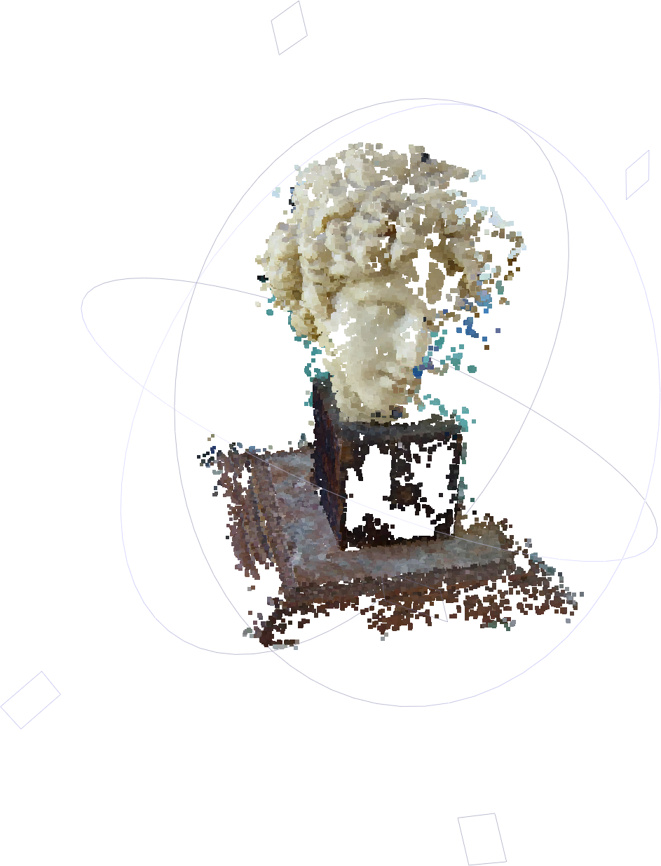
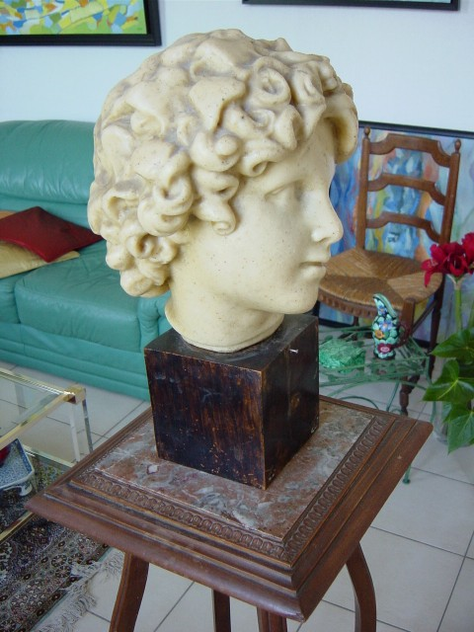
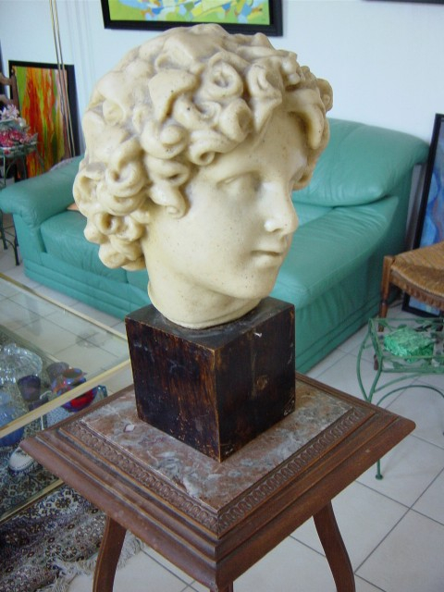
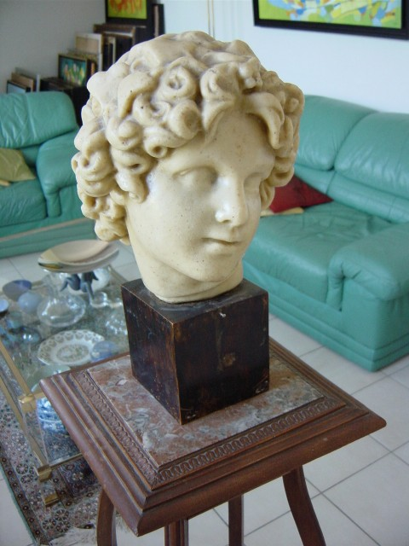
+
+
=
Multi-view 3D Reconstruction
2022.10.13
杨乐园

Slide 2
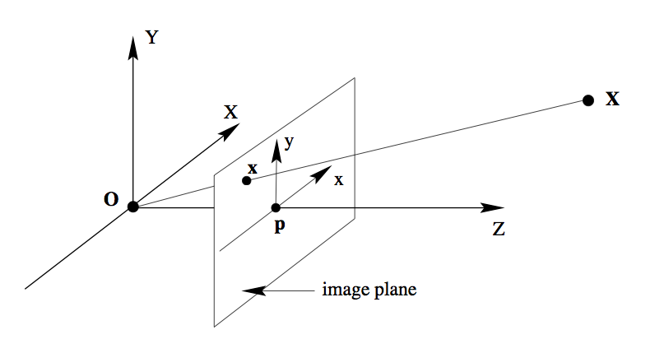
When they take a picture:
Up to a scale

Slide 3
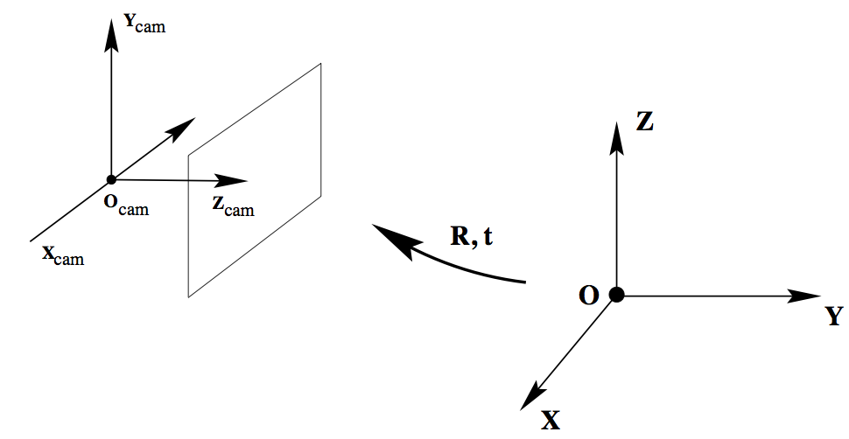
In a real world
Model-view
Transformation
Camera Coordinate System
World Coordinate System

Slide 4
World Coor. → Camera Coor.
Camera Parameter
Camera Projection Matrix
Intrinsic
Extrinsic

Slide 5
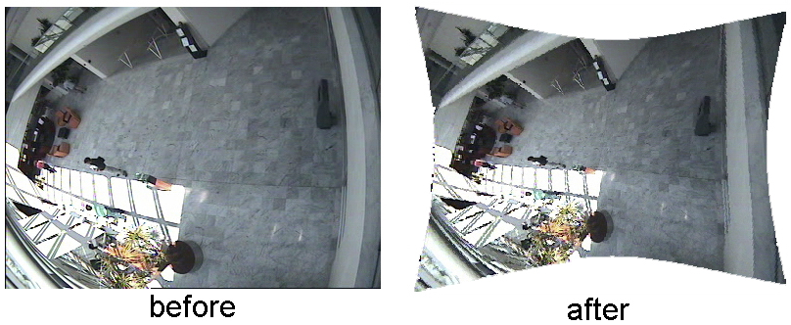
Other Intrinsic Camera Parameters
Principle point offset
especially when images are cropped (Internet)
Skew
Radial distortion (due to optics of the lens)

Slide 6
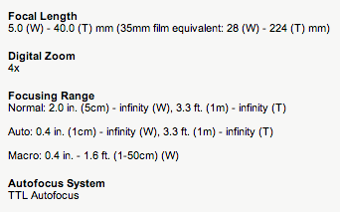
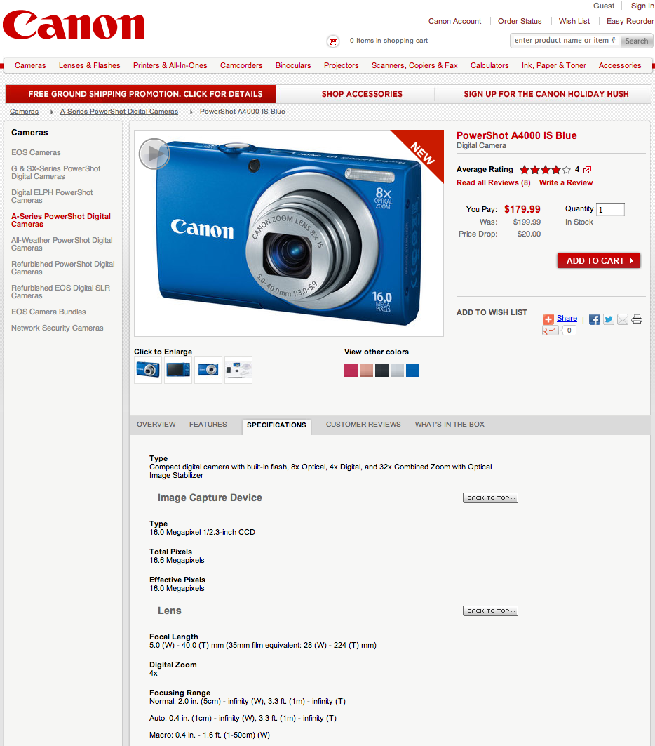
White-board Exercise
I brought a normal compact digital camera.
I took a picture at resolution 640x480 pixels.
What is the possible value of the focal length ?
full-frame 35mm = width 36 mm height 24 mm
http://en.wikipedia.org/wiki/Angle_of_view
http://goo.gl/ENaw4

Slide 7
Wait: How to get the focal length?
Auto-calibration
Self-Calibration and Metric Reconstruction in spite of Varying and Unknown Internal Camera Parameters, M Pollefeys, R Koch and L Van Gool, 1998. http://mit.edu/jxiao/Public/software/autocalibrate/autocalibration_lin.m
Grid Search to look for the solution with minimal reprojection error
for f=min_f:max_f
do everything, then obtain reprojection error after bundle adjustment
Optimize for this value in bundle adjustment
Camera Calibration (with checkerboard)
http://www.vision.caltech.edu/bouguetj/calib_doc/
EXIF of JPEG file recorded from digital camera
Read the code of Bundler to understand how to convert EXIF into focal length value
http://phototour.cs.washington.edu/bundler/

Slide 8
When people take three pictures with same camera setting:
Image 1
Image 3
R₁,t₁
R₃,t₃
Image 2
R₂,t₂

Slide 9
When people take three pictures with same camera setting:
Point 1
Point 2
Point 3
Image 1
Image 2
Image 3
Same Camera Same Setting = Same

Slide 10
Triangulation
Image 1
Image 3
R₁,t₁
R₃,t₃
Image 2
R₂,t₂

Slide 11
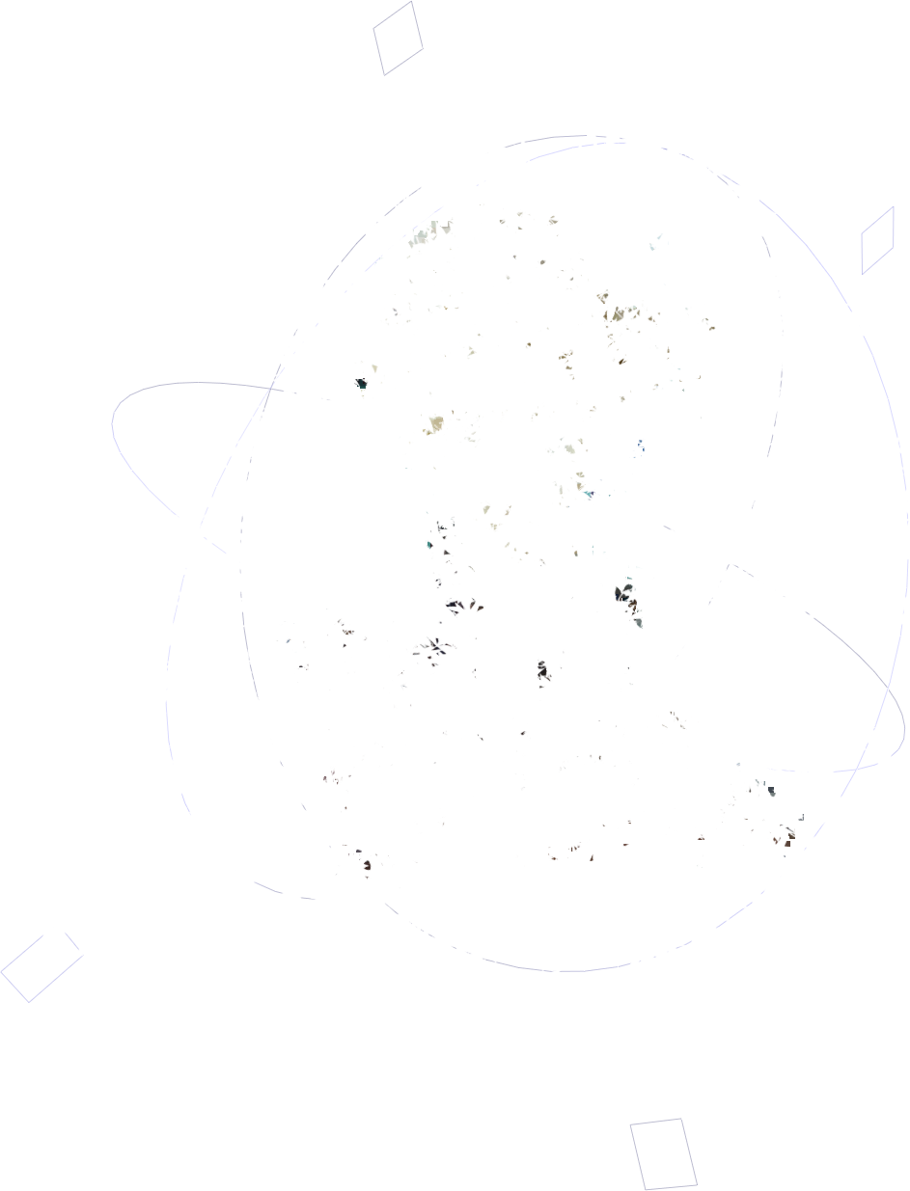
Steps
Images → Points: Structure from Motion
Points → More points: Multiple View Stereo
Points → Meshes: Model Fitting
Meshes → Models: Texture Mapping
Images → Models: Image-based Modeling
+
=
+
+
=

Slide 12
Steps
Images → Points: Structure from Motion
Points → More points: Multiple View Stereo
Points → Meshes: Model Fitting
Meshes → Models: Texture Mapping
Images → Models: Image-based Modeling
+
=
+
+
+
=

Slide 13
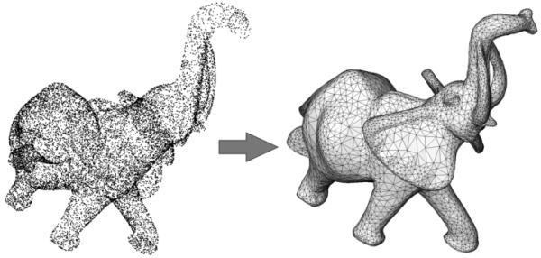
Steps
Images → Points: Structure from Motion
Points → More points: Multiple View Stereo
Points → Meshes: Model Fitting
Meshes → Models: Texture Mapping
Images → Models: Image-based Modeling
+
=

Slide 14
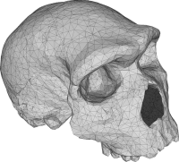
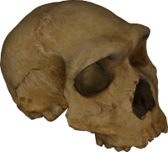
Steps
Images → Points: Structure from Motion
Points → More points: Multiple View Stereo
Points → Meshes: Model Fitting
Meshes → Models: Texture Mapping
Images → Models: Image-based Modeling
+
=

Slide 15
Finished!
Images → Points: Structure from Motion
Points → More points: Multiple View Stereo
Points → Meshes: Model Fitting
Meshes → Models: Texture Mapping
Images → Models: Image-based Modeling
+
=
+
+
=

Slide 16
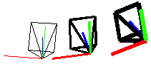
Steps
Images → Points: Structure from Motion
Points → More points: Multiple View Stereo
Points → Meshes: Model Fitting
Meshes → Models: Texture Mapping
Images → Models: Image-based Modeling
+
=
+
+
=

Slide 17
Structure From Motion
Structure = 3D Point Cloud of the Scene
Motion = Camera Location and Orientation
SFM = Get the Point Cloud from Moving Cameras
Structure and Motion: Joint Problems to Solve
+
+
=

Slide 18
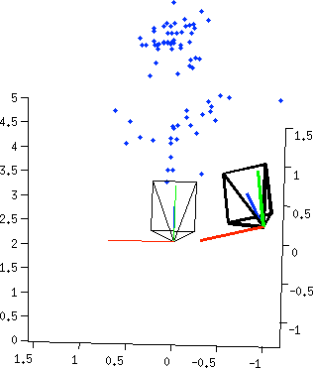
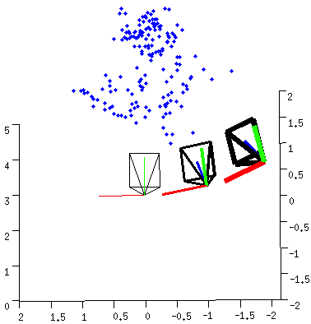
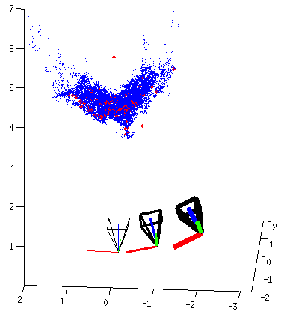
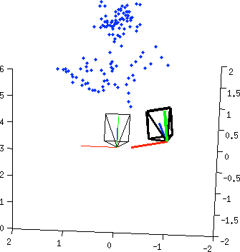
Pipeline
Structure from Motion (SFM)
Multi-view Stereo (MVS)

Slide 19
Pipeline
Structure from Motion (SFM)
Multi-view Stereo (MVS)

Slide 20
Two-view Reconstruction
keypoints
match
fundamental
matrix
essential
matrix
triangulation
[R|t]
keypoints

Slide 21

Keypoints Detection
keypoints
match
fundamental
matrix
essential
matrix
triangulation
[R|t]
keypoints

Slide 22
Descriptor for each point
SIFT
descriptor
SIFT
descriptor
keypoints
match
fundamental
matrix
essential
matrix
triangulation
[R|t]
keypoints

Slide 23

Same for the other images
SIFT
descriptor
SIFT
descriptor
SIFT
descriptor
SIFT
descriptor
keypoints
match
fundamental
matrix
essential
matrix
triangulation
[R|t]
keypoints

Slide 24
Point Match for correspondences
SIFT
descriptor
SIFT
descriptor
SIFT
descriptor
SIFT
descriptor
keypoints
match
fundamental
matrix
essential
matrix
triangulation
[R|t]
keypoints

Slide 25

Fundamental Matrix
Image 1
R₁,t₁
Image 2
R₂,t₂

Slide 26
Estimating Fundamental Matrix
Given a correspondence
The basic incidence relation is
Need 8 points

Slide 27
Estimating Fundamental Matrix
for 8 point correspondences:
Direct Linear Transformation (DLT)

Slide 28
Algebraic Error vs. Geometric Error
Algebraic Error
Geometric Error (better)
Unit: pixel
Solved by (non-linear) least square solver (e.g. Ceres)

Slide 29
RANSAC to Estimate Fundamental Matrix
For many times
Pick 8 points
Compute a solution for using these 8 points
Count number of inliers
Pick the one with the largest number of inliers

Slide 30
Fundamental Matrix → Essential Matrix
Image 1
R₁,t₁
Image 2
R₂,t₂

Slide 31
Essential Matrix →
Image 1
R₁,t₁
Image 2
R₂,t₂

Slide 32
Essential Matrix →
Result 9.19. For a given essential matrix
and the first camera matrix , there are four possible choices for the second camera matrix :
Page 259 of the bible (Multiple View Geometry, 2nd Ed)

Slide 33
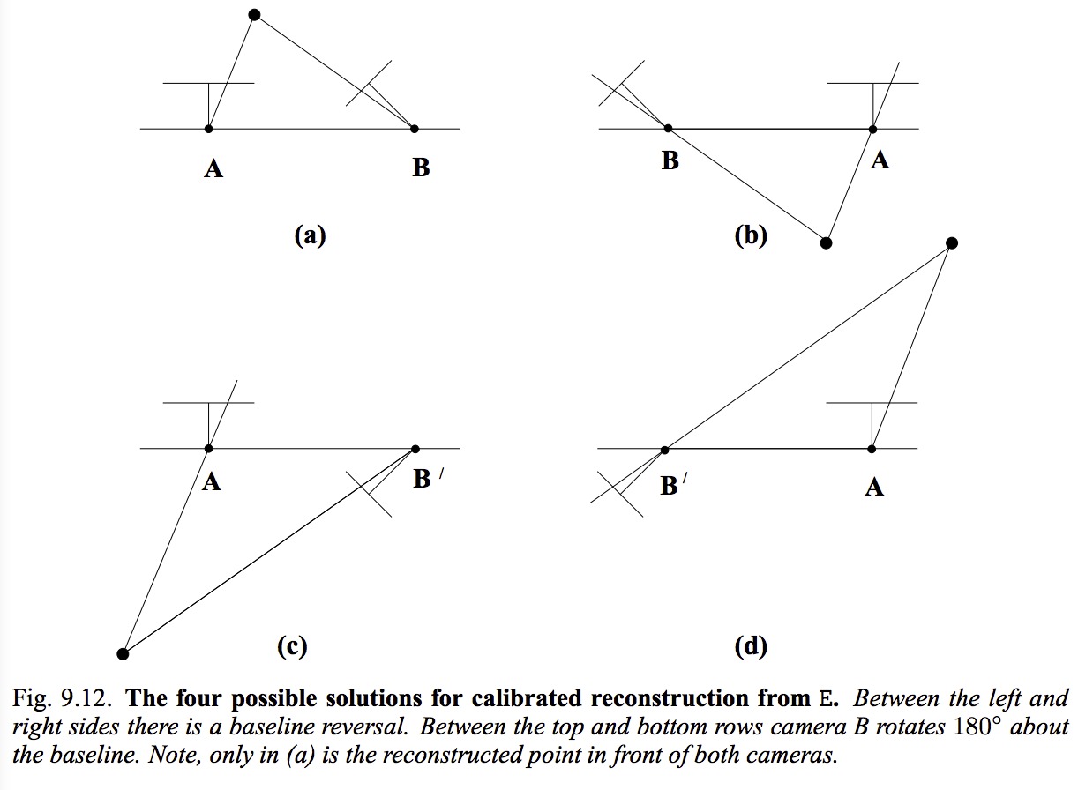
Four Possible Solutions
Page 260 of the bible (Multiple View Geometry, 2nd Ed)

Slide 34
In front of the camera?
Camera Extrinsic
Camera Center
View Direction
Camera Coordinate System
World Coordinate System

Slide 35
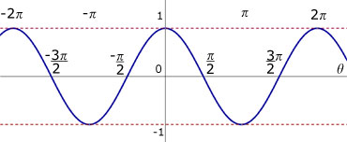
In front of the camera?
A point
Direction from camera center to point
Angle Between Two Vectors
Angle Between and View Direction
Just need to test

Slide 36
Pick the Solution
With maximal number of points in front of both cameras.
Page 260 of the bible (Multiple View Geometry, 2nd Ed)

Slide 37
Pipeline
Next

Slide 38
Merge Two Point Cloud
There can be only one

Slide 39
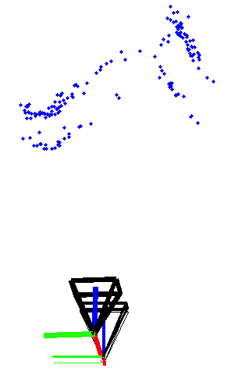
Oops
See From a Different Angle

Slide 40
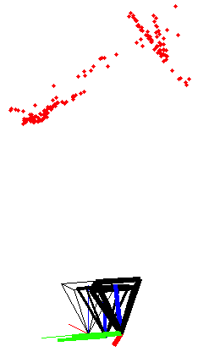
Bundle Adjustment

Slide 41
Rethinking the SFM problem
Input: Observed 2D image position
Output:
Unknown Camera Parameters (with some guess)
Unknown Point 3D coordinate (with some guess)

Slide 42
Bundle Adjustment
A valid solution and
must let
Re-projection
=
Observation

Slide 43
Bundle Adjustment
A valid solution and
must let the Re-projection close to the Observation, i.e. to minimize the reprojection error

Slide 44
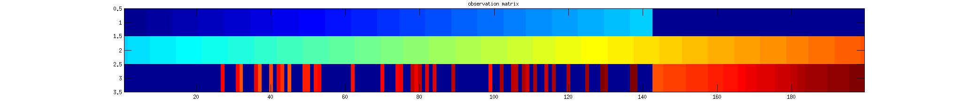
Bundle Adjustment
A valid solution and
must let the Re-projection close to the Observation, i.e. to minimize the reprojection error
Camera
Points

Slide 45
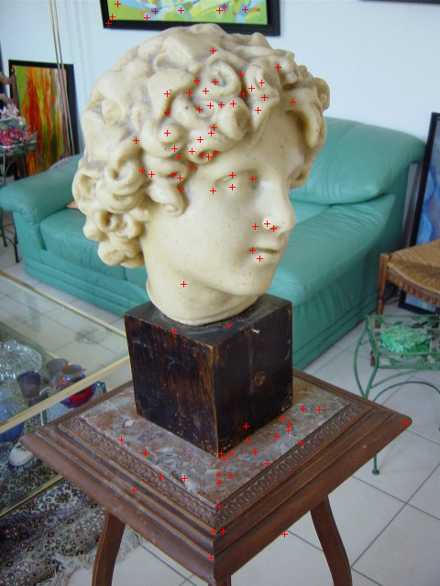
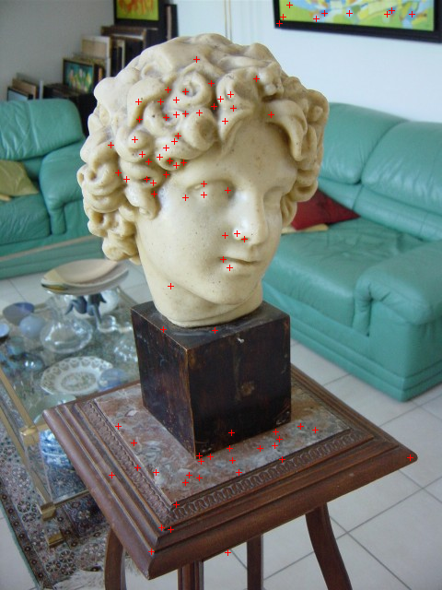
Linking
Linking
SIFT Matching
SIFT Matching
Camera
Points

Slide 46
Solving This Optimization Problem
Theory:
The Levenberg–Marquardt algorithm
Practice:
The Ceres-Solver from Google
http://en.wikipedia.org/wiki/Levenberg-Marquardt_algorithm
http://code.google.com/p/ceres-solver/

Slide 47
Non-linear Least Square Cuboid Reconstruction
Observation:
Pixel location of the 7 (or 6) corners
Parameters to be estimated:
Cuboid: Height h x Width w x 1
Camera: Intrinsic K and Extrinsic R, t
http://mit.edu/jxiao/Public/software/fitCuboid/

Slide 48
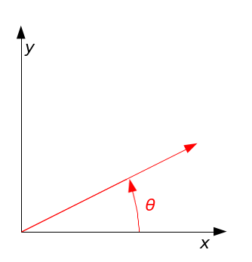
Parameterizing Rotation Matrix
2D Rotation

Slide 49
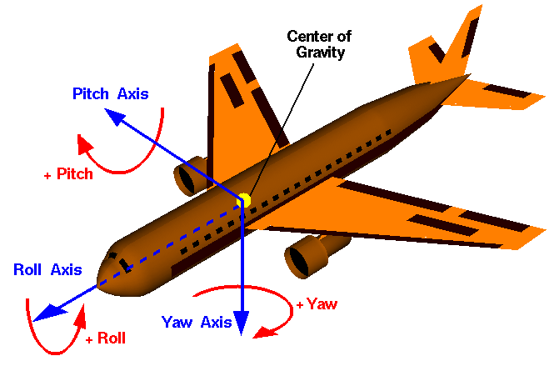
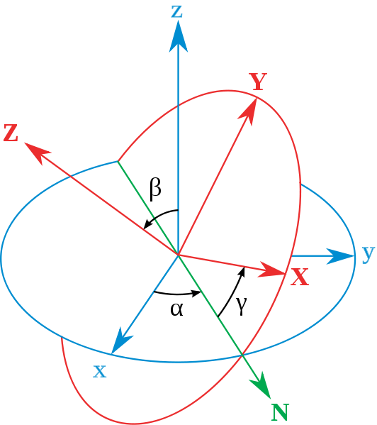
3D Rotation
Yaw, pitch and roll are
Euler angles are
http://en.wikipedia.org/wiki/Rotation_matrix

Slide 50
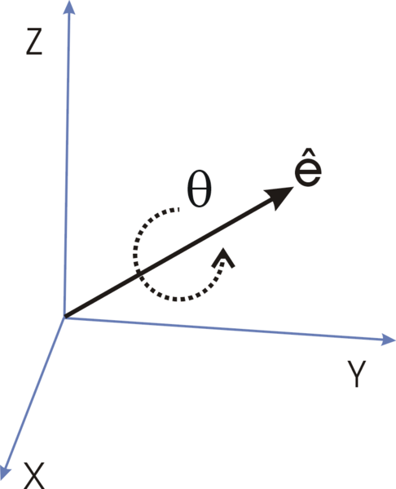
3D Rotation
Axis-angle representation
Quaternions
Avoid Gimbal Lock!
Recommendation!
Triplet Representation (3 dof)← Not over-parameterized
Rodrigues' rotation formula
http://en.wikipedia.org/wiki/Axis-angle_representation
http://en.wikipedia.org/wiki/Quaternions_and_spatial_rotation
http://en.wikipedia.org/wiki/Rodrigues%27_rotation_formula

Slide 51
Matlab Symbolic Operation
How to derive complicated equations
(after passing math classes)?
syms h, w, K, alpha, beta, gamma, tx, ty, tz
X = [h; w; f];
Y = […] * X;
Z = K* Y;
x = Z(1:2,:) ./ Z([3,3],:);
ccode(x,’file’,’x.cpp’); % ←matlab will generate C code for x
http://www.mathworks.com/help/symbolic/sym.html
http://mit.edu/jxiao/Public/software/fitCuboid/fitCuboid/derive4cuboid.m

Slide 52
Ceres for Bundle Adjustment
A valid solution and
must let the Re-projection close to the Observation, i.e. to minimize the reprojection error
Camera
Points

Slide 53
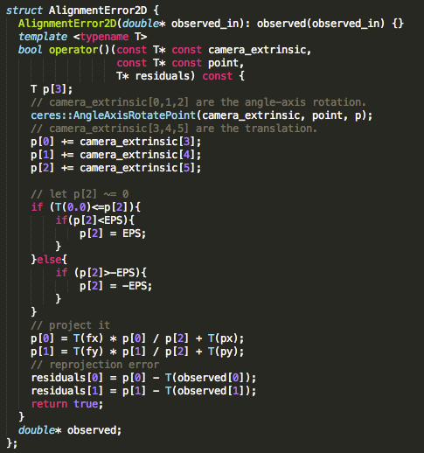
ba2D.cc
To avoid divide by 0

Slide 54
Initialization Matters
Input: Observed 2D image position
Output:
Unknown Camera Parameters (with some guess)
Unknown Point 3D coordinate (with some guess)

Slide 55
Pipeline
Next

Slide 56
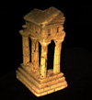
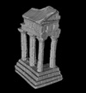
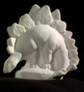
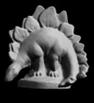
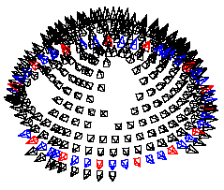
Multiple View Stereo
State-of-the-art:
PMVS: http://grail.cs.washington.edu/software/pmvs/
Accurate, Dense, and Robust Multi-View Stereopsis, Y Furukawa and J Ponce, 2007.
Benchmark:
http://vision.middlebury.edu/mview/
A Comparison and Evaluation of Multi-View Stereo Reconstruction Algorithms.
SM Seitz, B Curless, J Diebel, D Scharstein, R Szeliski. 2006.
Baseline:
Multi-view stereo revisited. M Goesele, B Curless, SM Seitz. 2006.

Slide 57
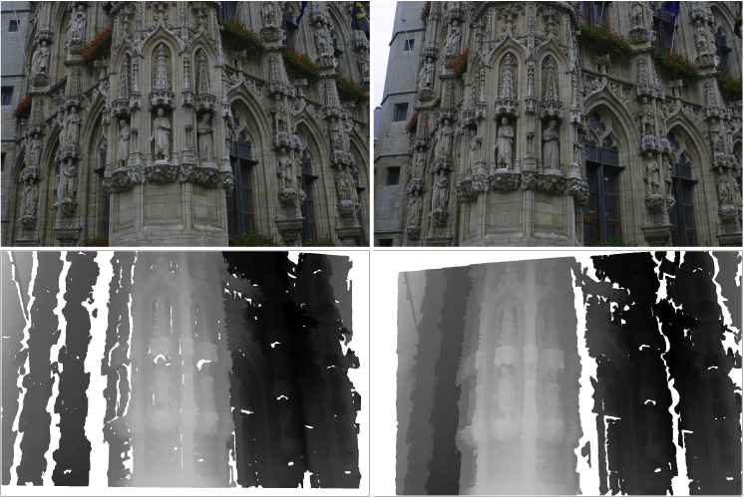
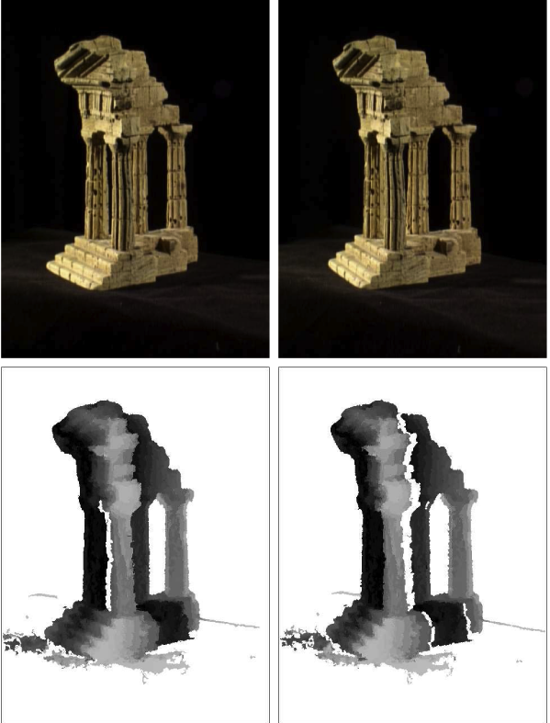
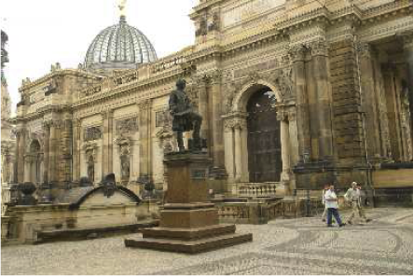
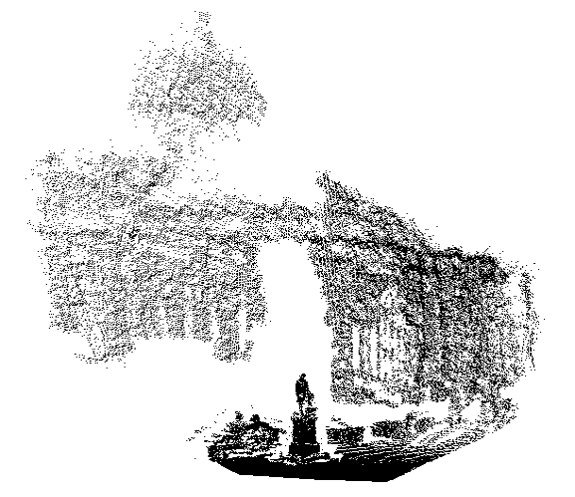
Key idea: Matching Propagation
[1] Learning Two-view Stereo Matching, J Xiao, J Chen, DY Yeung, and L Quan, 2008.
[2] Accurate, Dense, and Robust Multi-View Stereopsis, Y Furukawa and J Ponce, 2007.
[3] Multi-view stereo revisited. M Goesele, B Curless, SM Seitz. 2006.
[4] Robust Dense Matching Using Local and Global Geometric Constraints, M Lhuillier & L Quan, 2000.
In another context:
[5] PatchMatch: A Randomized Correspondence Algorithm for Structural Image Editing,
C Barnes, E Shechtman, A Finkelstein, and DB Goldman, 2009.

Slide 58
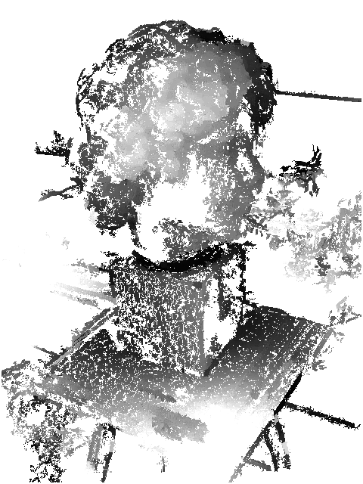
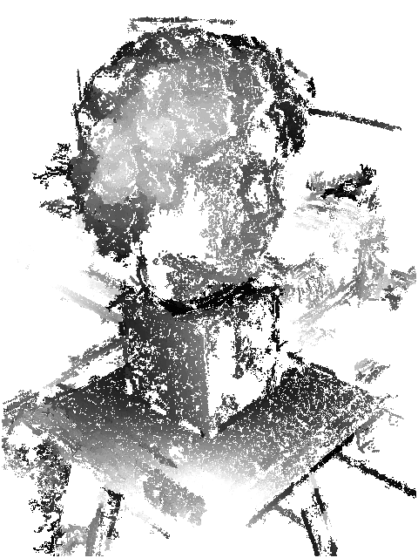
Simplest Matching Propagation
We are going to learn a very simple algorithm that is implemented in the SFMedu program.

Slide 59
Descriptor: ZNCC (Zero-mean Normalized Cross-Correlation)
Invariant to linear radiometric changes
More conservative than others such as sum of absolute or square diﬀerences in uniform regions
More tolerant in textured areas where noise might be important
Notes:
http://www.lasmea.univ-bpclermont.fr/Personnel/Maxime.Lhuillier/Papers/Eccv02.pdf
http://www.lasmea.univ-bpclermont.fr/Personnel/Maxime.Lhuillier/Papers/Icpr00.pdf
http://ieeexplore.ieee.org/stamp/stamp.jsp?tp=&arnumber=1641048

Slide 60
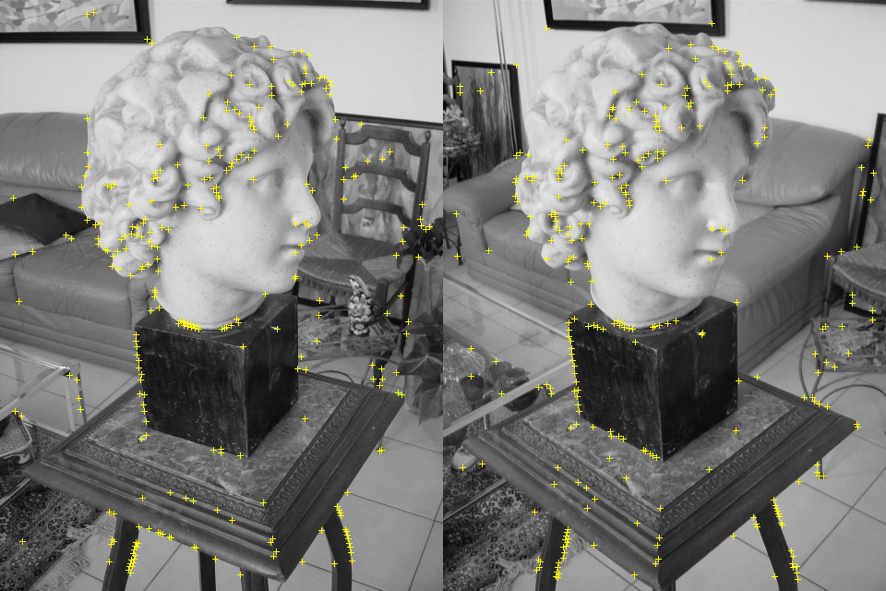
Seed for propagation

Slide 61
Matching Propagation (propagate.m)
Maintain a priority queue Q
Initialize: Put all seeds into Q with their ZNCC values as scores
For each iteration:
Pop the match with best ZNCC score from Q
Add new potential matches in their immediate spatial neighborhood into Q
Safety: handle uniqueness, and propagate only on matchable area

Slide 62
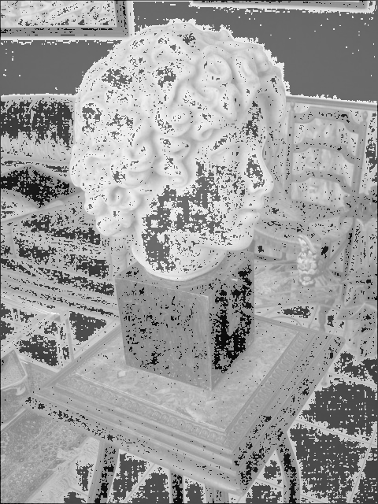
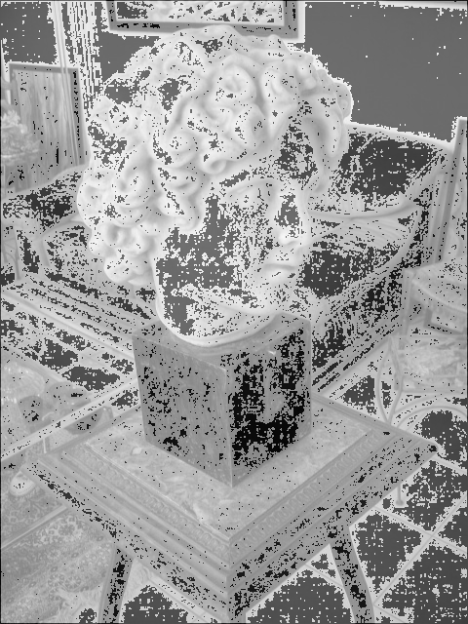
Matchable Area
the area with maximal gradience > threshold

Slide 63
Result (denseMath/run.m)

Slide 64
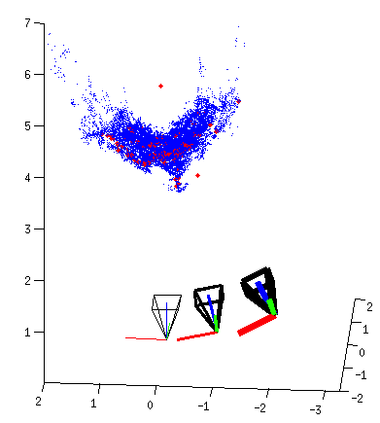
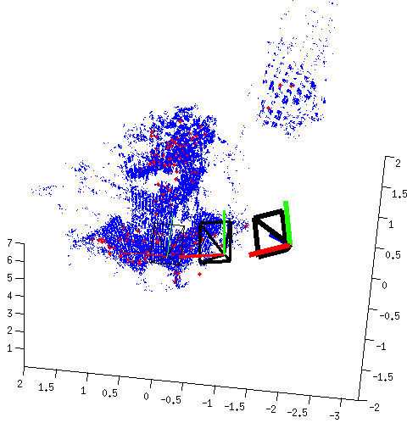
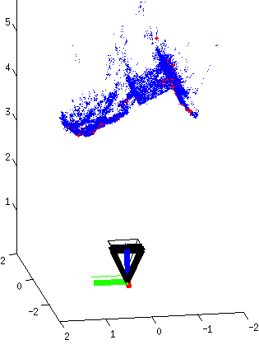
Final Result

Slide 65
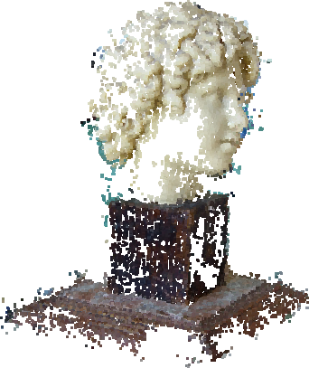
Colorize the Point Cloud

